Slide 1

Alzheimer Disease Detection and Mental Stress Analysis using EEG Signals
SRM INSTITUTE OF SCIENCE AND TECHNOLOGY
FACULTY OF ENGINEERING AND TECHNOLOGY
DEPARTMENT OF NETWORKING AND COMMUNICATIONS
18CSP109L MAJOR PROJECT
Student 1 Reg No: RA2011030010048
Guide name and Designation:
Dr. Prabakeran S (Assistant Professor)
Department of Networking And Communications

Slide 2
Contents
Project Title
• Abstract
• Introduction
• Motivation
• Literature Review
• Challenges and limitations in existing system
• Objectives of the project
• Innovation idea of the project
• Scope and application of the project
• Architecture
• Proposed Modules and their algorithm description
• UML Diagrams for the proposed modules (Appropriate UML diagrams to be included)
• Implementation with demo

Slide 3
ABSTRACT
Alzheimer's Disease presents a significant global health challenge, with early detection crucial for effective management.
This study proposes a novel approach utilizing machine learning algorithms to detect AD through analysis of Electroencephalography (EEG) signals.
EEG signals offer valuable insights into brain activity and have shown promise as a noninvasive biomarker for AD detection.
Various machine learning techniques, including Support Vector Machines (SVM), Random Forest, and Convolutional Neural Networks (CNN), are explored for their effectiveness in distinguishing AD patients from healthy individuals.
Feature extraction methods are employed to extract discriminative features from EEG signals, enhancing the performance of the classification models.
The proposed methodology demonstrates high accuracy, sensitivity, and specificity in distinguishing AD patients from controls, showing potential for reliable early detection of the disease.
Implementing machine learning algorithms for Alzheimer detection through EEG signals analysis holds promise for improving diagnostic accuracy and facilitating timely interventions, ultimately enhancing patient outcomes and quality of life.
The proposed system to be developed by our team is expected to have an accuracy of 97%.

Slide 4
INTRODUCTION
Alzheimer's Disease poses a significant challenge in healthcare due to its progressive nature and impact on cognition sense of human beings.
Early detection of Alzheimer is crucial for effective intervention and management of the disease leading the patient to survive a comfortable life.
EEG (Electroencephalogram) signals offer valuable insights into brain activity, serving as a potential biomarker for Alzheimer
Machine learning algorithms provide a promising avenue for analyzing EEG signals to detect patterns indicative of Alzheimer Disease.
This research aims to leverage machine learning techniques to develop a reliable and efficient system for Alzheimer’s Disease detection.
By analyzing EEG data, subtle abnormalities associated with Alzheimer can be identified, aiding in early diagnosis. Additionally it can also give a direct indication towards mental health.
Ultimately, this approach could lead to improved diagnostic accuracy and timely intervention, enhancing the quality of life for individuals at risk of Alzheimer's Disease.

Slide 5
MOTIVATION
Detecting Alzheimer's through EEG signals offers a noninvasive and costeffective diagnostic approach.
Machine learning algorithms can identify subtle patterns in EEG data that may indicate early signs of Alzheimer's.
Early detection enables timely interventions, potentially slowing the progression of the disease.
EEGbased detection can complement existing diagnostic methods, enhancing overall accuracy.
Machine learning facilitates personalized medicine by tailoring interventions to individual patients based on EEG analysis.
EEG data analysis holds promise for monitoring disease progression and treatment efficacy over time.
Advancements in machine learning can lead to more accurate and reliable Alzheimer's detection, improving patient outcomes.

Slide 6
LITERATURE REVIEW
In paper [1], it explains how Gaussian Naïve Bayes algorithm can be used to detect the presence or absence of Alzheimer disease. However it does not give any indication about the stages and has accuracy of 78% only.
In paper [2], the authors aim at designing a system that can try to detect the stage of Alzheimer disease from the MRI images of the brain done in a CTscan. However it fails as bulges and convolutions are present even in healthy brains.
In paper [3], the researchers have devised a method for CNN based deep feature analysis of the MRI brain images but again fails due to curse of dimensionality. The model generates a whopping accuracy of 94% but includes white noise with increase in the data set size.
The paper [4], analyses the human emotional peaks as a medium for measurement of Alzheimer using Deep GAN voice based analysis. But voice actors can mimic an Alzheimer voice and hence stands no chance to accurate detection.
The paper [5], describes about biomarkers study (which is similar to our process). However the model is overtuned and is susceptible to white noise. Hence even with 92.4% accuracy we consider this missing a mark in the long run.

Slide 7
CHALLENGES AND LIMITATIONS
Interpretation Complexity: EEG signals are intricate and multifaceted, making their interpretation challenging for machine learning algorithms due to noise, artifacts, and variability.
Data Quality: Obtaining high quality EEG data is challenging due to factors such as electrode placement, signal interference, and patient movement, leading to inconsistencies in the dataset.
Limited Sample Size: Availability of large, diverse datasets for training ML models is restricted, hindering the generalizability and effectiveness of algorithms.
Feature Selection: Identifying relevant features from EEG signals for Alzheimer's detection is complex, as it requires domain expertise and may involve subjective decision making.
Class Imbalance: Imbalanced distribution of Alzheimer's and nonAlzheimer's cases in EEG datasets can skew model performance, leading to biased predictions.
CrossSubject Variability: EEG signals exhibit variability across individuals, complicating the development of robust models that can generalize well across different patients.
Clinical Validation: The translation of machine learning models for Alzheimer's detection from EEG signals into clinical practice requires rigorous validation and regulatory approval, which poses significant challenges and limitations.

Slide 8
OBJECTIVES
Develop a machine learning model to accurately classify EEG signals associated with Alzheimer's disease.
Explore feature extraction techniques to identify distinctive patterns indicative of Alzheimer's disease in EEG data.
Optimize model performance to achieve high sensitivity and specificity in Alzheimer's disease detection from EEG signals.
Investigate the potential of deep learning algorithms for capturing complex temporal dependencies in EEG data related to Alzheimer's disease.
Validate the developed model using diverse datasets to ensure robustness and generalizability across different populations.
Assess the feasibility of realtime Alzheimer's disease detection based on EEG signals for potential clinical applications.
Collaborate with neurologists and medical professionals to integrate the developed model into clinical workflows for early diagnosis and intervention.

Slide 9
INNOVATION
Machine learning algorithms analyze EEG signals to detect patterns indicative of Alzheimer's disease.
These algorithms can identify subtle changes in brain activity that may precede clinical symptoms.
EEG data provides a noninvasive and costeffective method for early detection.
Advanced algorithms can distinguish between healthy individuals and those with Alzheimer's with high accuracy.
Early detection allows for timely intervention and potentially more effective treatment strategies.
Continuous monitoring using EEG and machine learning enables tracking disease progression over time.
Integration of EEGbased detection into routine healthcare practices offers a promising avenue for early intervention and improved patient outcomes.

Slide 10
SCOPE
Machine learning algorithms offer promising potential for Alzheimer's Disease detection through EEG signals analysis.
EEG signals provide valuable insights into brain activity, offering a noninvasive means of detecting neurological disorders.
These algorithms can identify patterns or abnormalities in EEG signals associated with Alzheimer's Disease progression.
Machine learning models can analyze vast amounts of EEG data quickly, potentially aiding in early diagnosis.
The scope lies in developing algorithms that can accurately distinguish between normal brain function and Alzheimer’s related abnormalities in EEG signals.
By leveraging machine learning, researchers aim to create predictive models for early detection and monitoring of Alzheimer's Disease.
Ultimately, the integration of EEG signal analysis with machine learning holds significant promise in advancing Alzheimer's Disease diagnosis and treatment.

Slide 11
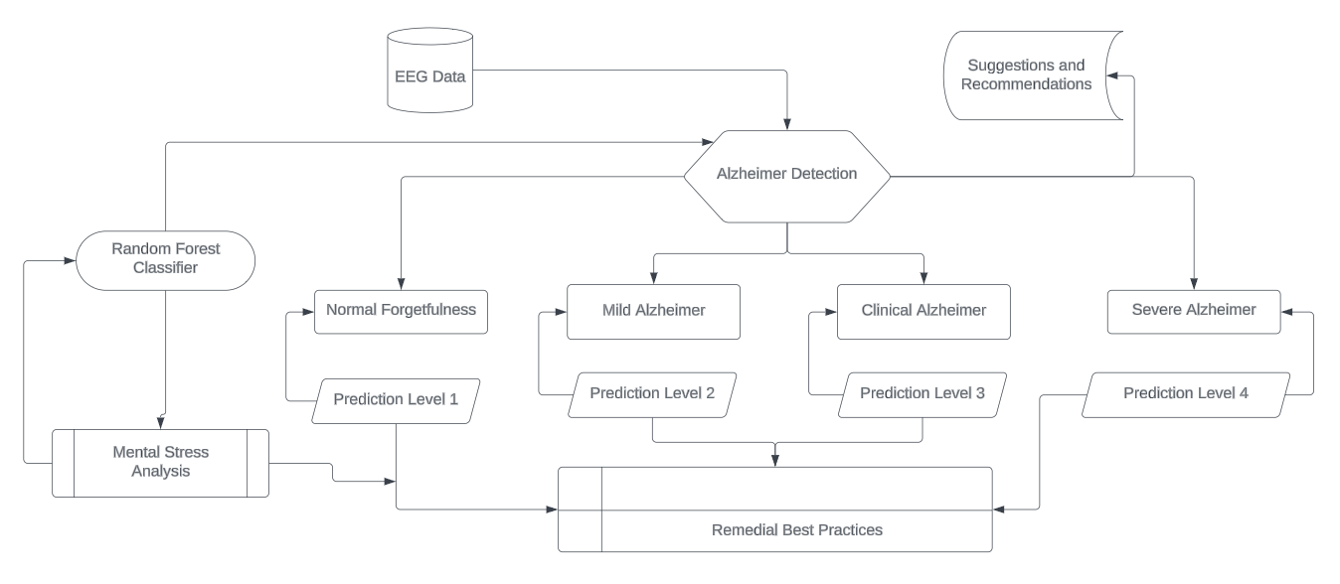
ARCHITECTURE

Slide 12
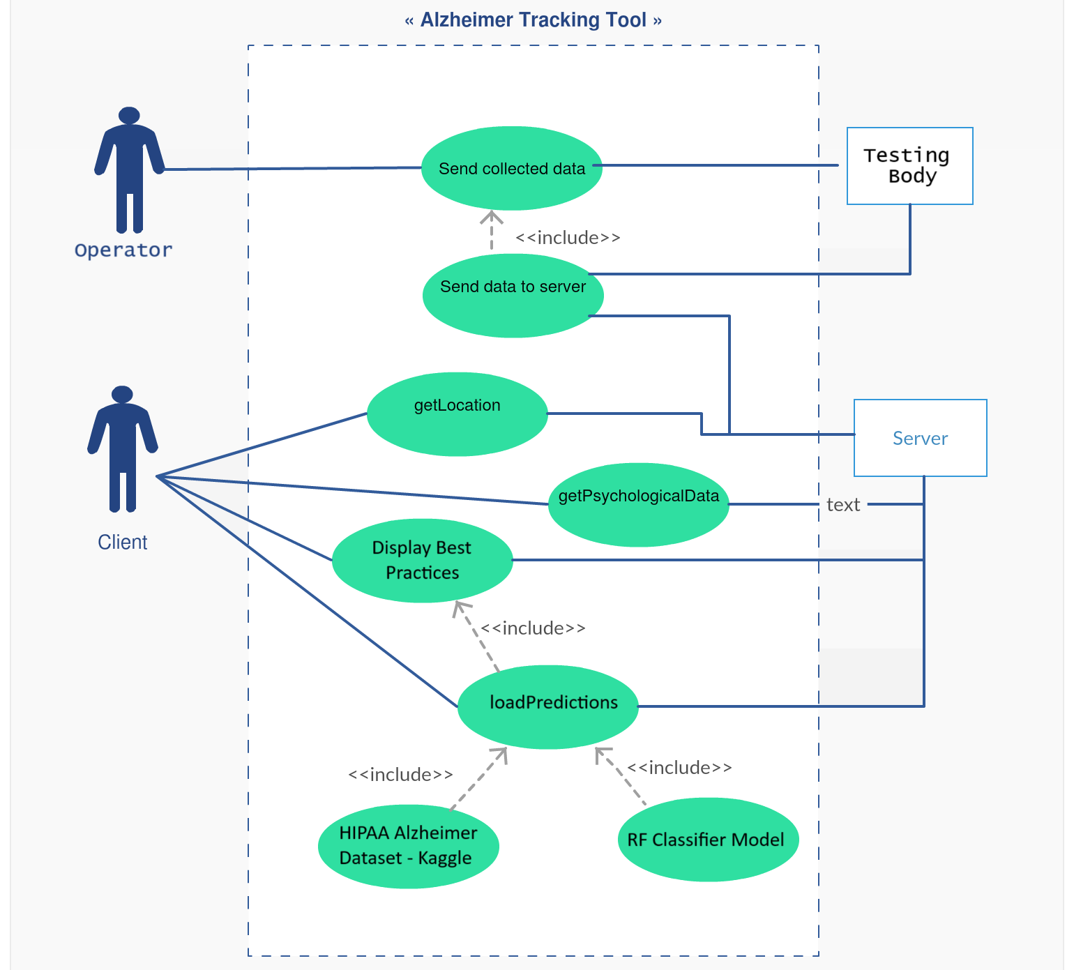
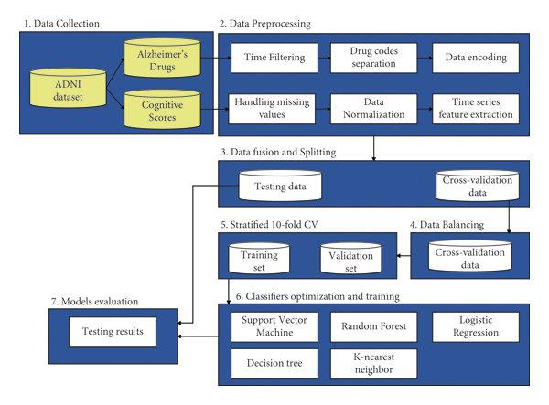
UML DIAGRAMS

Slide 13
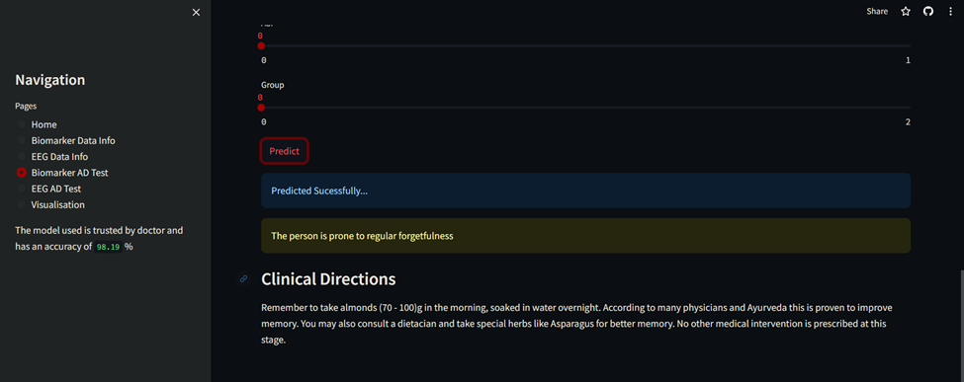
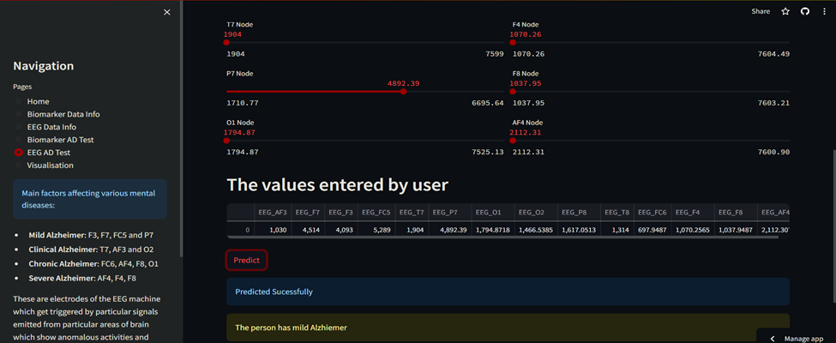
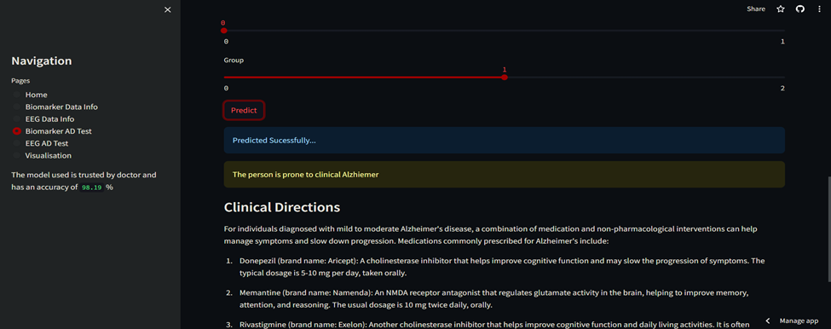
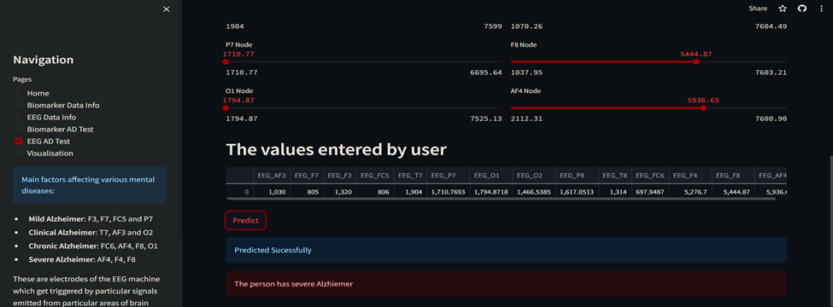
IMPLEMENTATION

Slide 14
RESULT AND CONCLUSION
Accuracy achieved in the project : 97% (approx.)
Response time : 2 – 5 sec.
Best practices score as per Google Lighthouse Reports: 96%
The expected outcomes have been satisfied by the application
The UI is user-friendly and is solving the purpose.
The application works lag free on multiple browsers.

Slide 15
THANK YOU!

